Slide 1
Parallax Occlusion Mapping
Law Smith & David Bocek

Slide 2
Problem
Not enough speed / memory for 3d details
Large stone bricks
Stones / sand
Bullet holes / destruction

Slide 3
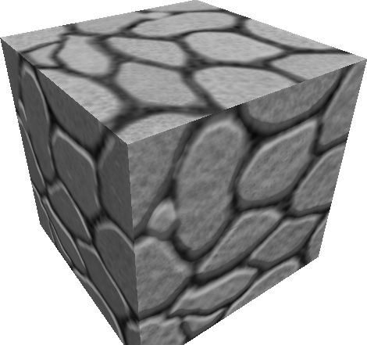
Problem
Normal mapping fails at grazing angles

Slide 4
Background
Parallax Occlusion Mapping (POM) [1]
Ex: CryEngine, Uningine (Oculus Rift)
Offset Textures on a plane
Further objects move faster
Closer objects move slower
[1] Dynamic Parallax Occlusion Mapping with Approximate Soft Shadows - Tatarchuk

Slide 5
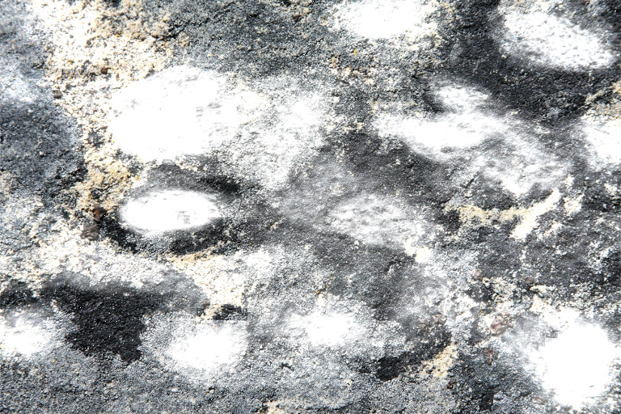
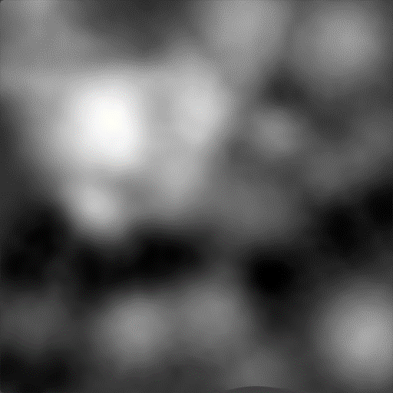
Approach
Texturemap AND heightmap
Change ray to 2D tangent space

Slide 6
Approach
Discretize curve
Adjust (u,v) cords based on intersection
T
Offset
h
0.0
Offset
Desired (u,v)
Hit (u,v)
1.0

Slide 7
Approach
Cast ray to lights for shadows
T
h
0.0
1.0

Slide 8
Results

